Slide 1

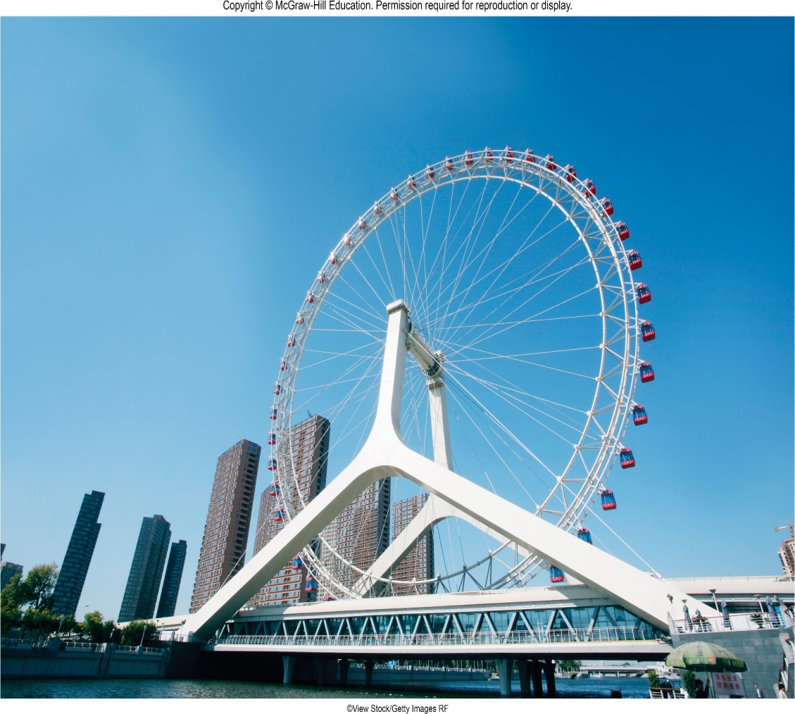
VECTOR MECHANICS FOR ENGINEERS
By: Fardinand P. Beer; E. Russell Johnston, Jr.; David F. Mazurek
ENGINEERING 3120
STATICS
CHAPTER 4
EQUILIBRIUM OF
RIGID BODIES
Slides revised by:
A.A. KHANDKER, Ph.D., P.E.
Copyright: McGraw Hill Education

Slide 2
EQUILIBRIUM OF RIGID BODIES - TOPICS IN CHAPTER 4
Introduction
Free-Body Diagram
Reactions at Supports and Connections for a Two-Dimensional Structure
Equilibrium of a Rigid Body in Two Dimensions
Statically Indeterminate Reactions
Sample Problem 4.1
Sample Problem 4.3
Sample Problem 4.4
Equilibrium of a Two-Force Body
Equilibrium of a Three-Force Body
Sample Problem 4.6
Equilibrium of a Rigid Body in Three Dimensions
Reactions at Supports and Connections for a Three-Dimensional Structure
Sample Problem 4.8

Slide 3
EQUILIBRIUM OF RIGID BODIES - INTRODUCTION
For a rigid body in static equilibrium, the external forces and moments are balanced and will impart no translational or rotational motion to the body.
The necessary and sufficient condition for the static equilibrium of a body are that the resultant force and couple from all external forces form a system equivalent to zero,
Resolving each force and moment into its rectangular components leads to 6 scalar equations which also express the conditions for static equilibrium,

Slide 4
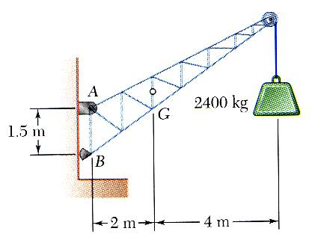
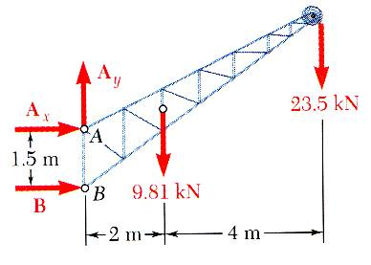
FREE-BODY DIAGRAM
First step in the static equilibrium analysis of a rigid body is identification of all forces acting on the body with a free-body diagram.
Select the extent of the free-body and detach it from the ground and all other bodies.
Indicate point of application, magnitude, and direction of external forces, including the rigid body weight.
Indicate point of application and assumed direction of unknown applied forces. These usually consist of reactions through which the ground and other bodies oppose the possible motion of the rigid body.
Include the dimensions necessary to compute the moments of the forces.

Slide 5
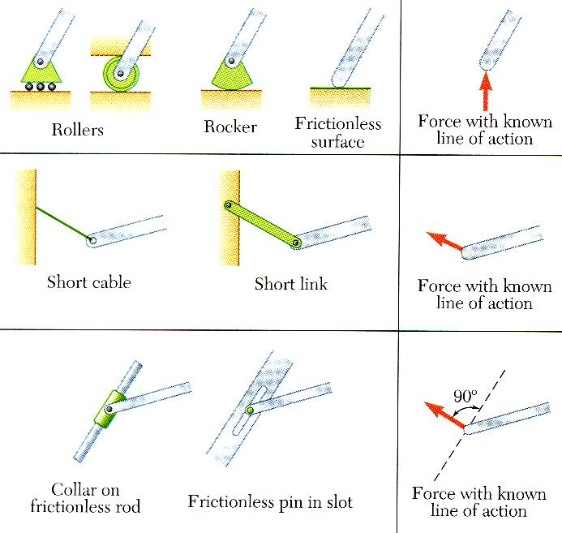
REACTION AT SUPPORTS AND CONNECTIONS FOR A TWO DIMENSIONAL STRUCTURE
Reactions equivalent to a force with known line of action.

Slide 6
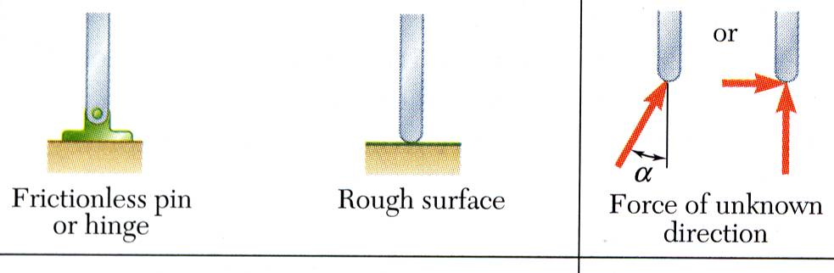
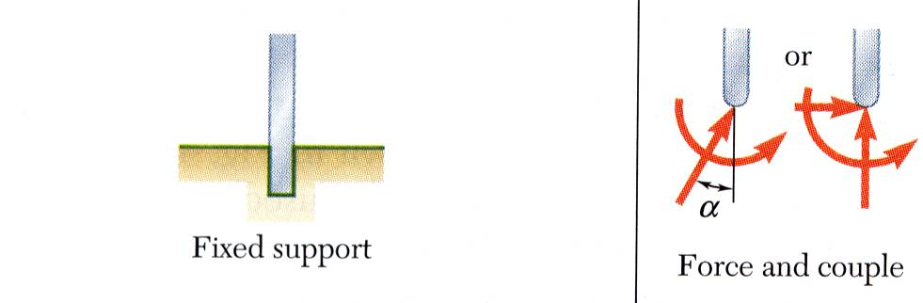
REACTION AT SUPPORTS AND CONNECTIONS FOR A TWO DIMENSIONAL STRUCTURE
Reactions equivalent to a force of unknown direction and magnitude.
Reactions equivalent to a force of unknown direction and magnitude and a couple of unknown magnitude

Slide 7
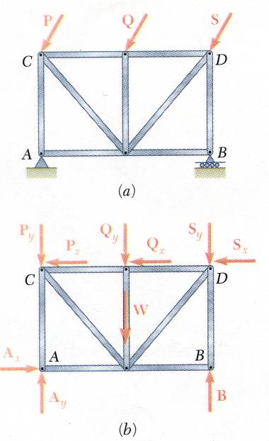
EQUILIBRIUM OF A RIGID BODY IN TWO DIMENSIONS
For all known external forces and moments acting on a two-dimensional structure,
Equations of equilibrium become
where A is any point in the plane of the structure.
The 3 equations can be solved for no more than 3 unknowns.
The 3 equations can not be augmented with additional equations, but they can be replaced

Slide 8
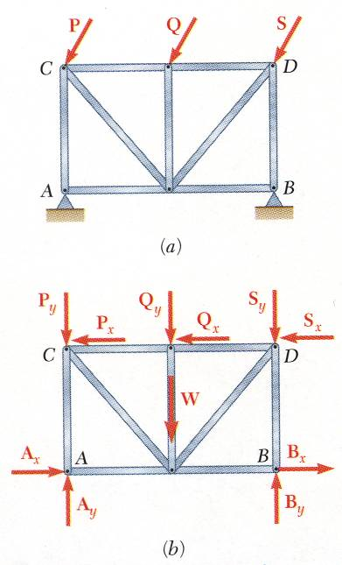
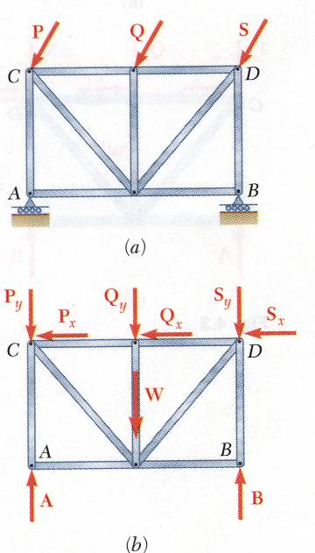
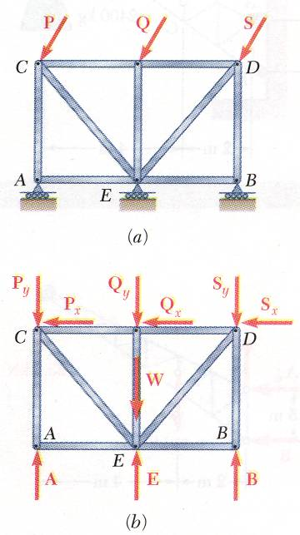
STATICALLY INDETERMINATE REACTIONS
More unknowns than equations
Fewer unknowns than equations, partially constrained
Equal number unknowns and equations but improperly constrained

Slide 9
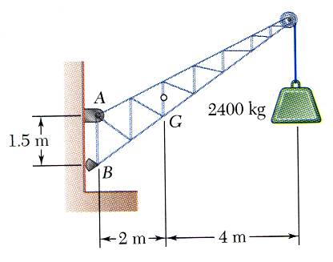
EXAMPLE PROBLEM 4.1
STRATEGY:
Create a free-body diagram for the crane
Determine B by solving the equation for the sum of the moments of all forces about A. Note there will be no contribution from the unknown reactions at A.
Determine the reactions at A by solving the equations for the sum of all horizontal force components and all vertical force components.
Check the values obtained for the reactions by verifying that the sum of the moments about B of all forces is zero.
A fixed crane has a mass of 1000 kg and is used to lift a 2400 kg crate. It is held in place by a pin at A and a rocker at B. The center of gravity of the crane is located at G.
Determine the components of the reactions at A and B.

Slide 10
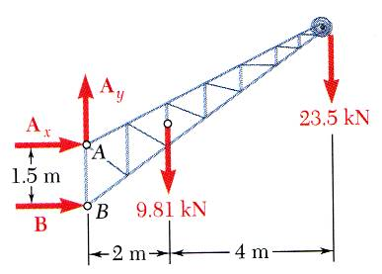
EXAMPLE PROBLEM 4.1 - SOLUTION
Determine B by solving the equation for the sum of the moments of all forces about A.
Determine the reactions at A by solving the equations for the sum of all horizontal forces and all vertical forces.
Create the free-body diagram
Check the values obtained.

Slide 11
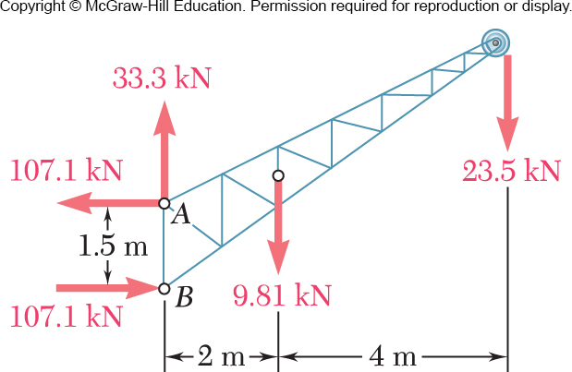
EXAMPLE PROBLEM 4.1 - SOLUTION
REFLECT and THINK:
You can check the values obtained for the reactions by recalling that the sum of the moments of all the external forces about any point must be zero. For example, considering point B, you can show
free-body diagram

Slide 12
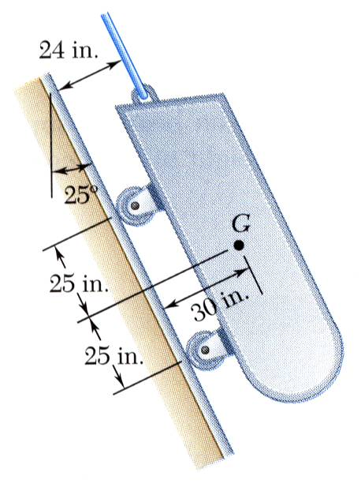
EXAMPLE PROBLEM 4.3
SOLUTION:
Create a free-body diagram for the car with the coordinate system aligned with the track.
Determine the reactions at the wheels by solving equations for the sum of moments about points above each axle.
Determine the cable tension by solving the equation for the sum of force components parallel to the track.
Check the values obtained by verifying that the sum of force components perpendicular to the track are zero.
A loading car is at rest on an inclined track. The gross weight of the car and its load is 5500 lb, and it is applied at at G. The cart is held in position by the cable.
Determine the tension in the cable and the reaction at each pair of wheels.

Slide 13
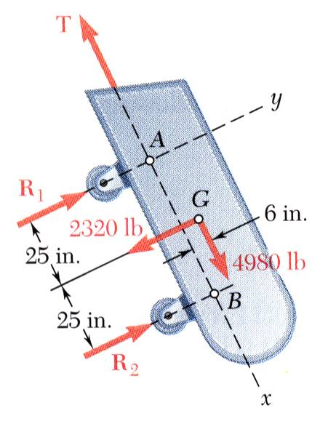
EXAMPLE PROBLEM 4.3 - SOLUTION
Determine the cable tension.
Determine the reactions at the wheels.
Create a free-body diagram

Slide 14
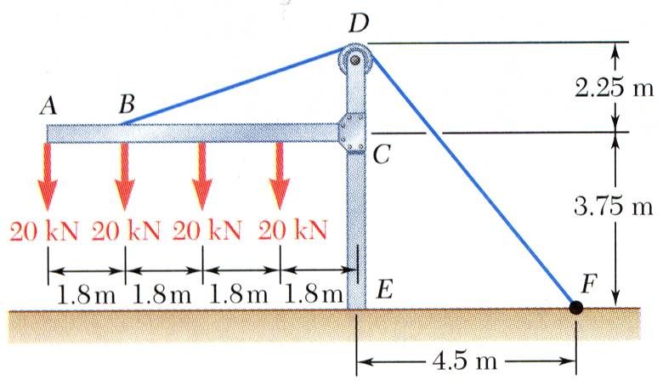
EXAMPLE PROBLEM 4.4
The frame supports part of the roof of a small building. The tension in the cable is 150 kN.
Determine the reaction at the fixed end E.
STRATEGY:
-Create a free-body diagram for the frame and cable.
Solve 3 equilibrium equations for the reaction force components and couple at E.
Solve 3 equilibrium equations for the reaction force components and couple at E.
REFLECT and THINK:
The cable provides a fourth constraint, making this situation statically indeterminate.
This problem therefore gave us the value of the cable tension.

Slide 15
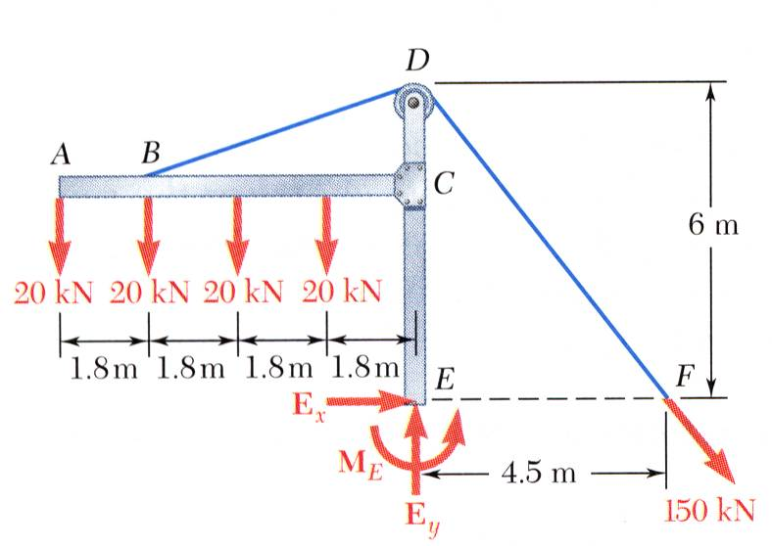
EXAMPLE PROBLEM 4.4 - SOLUTION
Solve 3 equilibrium equations for the reaction force components and couple.
Or, E_{x} + sin (36.9º) (150kN) = 0
Create a free-body diagram for the frame and cable.
Or, E_{y} -4(20kN)- cos (36.9º) (150kN) = 0

Slide 16
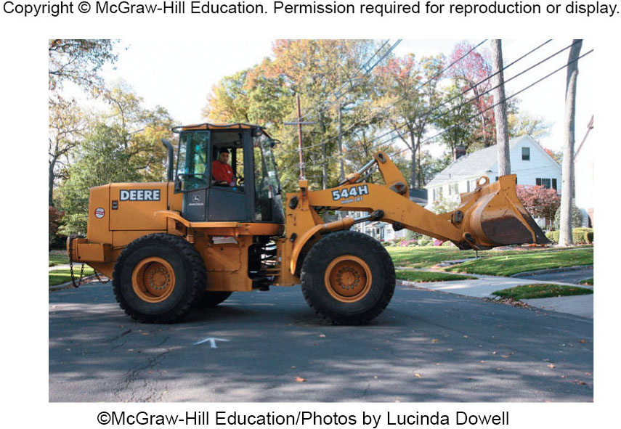
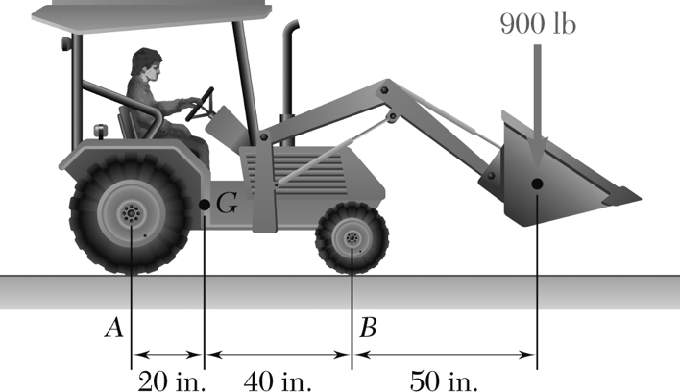
PRACTICE PROBLEM
A 2100-lb tractor is used to lift 900 lb of gravel. Determine the reaction at each of the two rear wheels and two front wheels
STRATEGY:
Create a free-body diagram for the Tractor.
apply the equilibrium conditions to generate the three equations, and use these to solve for the desired quantities.
F_{A}
2100 lb
F_{B}

Slide 17
PRACTICE PROBLEM - SOLUTION
Reactions at A and B are the two unknown forces.
Moment about A or B will be 0
Using
F_{A}
2100 lb
F_{B}
F_{A} . (60 in) + 2100lb . (40 in) – 900 lb . (50 in) = 0
or, 84000 lb.in - 45000 lb.in = F_{A} . (60 in)
Or, 39000/60 = F_{A} .
F_{A}=650 lb,
so the reaction at each of the rear wheel is 325 lb

Slide 18
PRACTICE PROBLEM - SOLUTION
Reactions at A and B are the two unknown forces.
Using
F_{A}
2100 lb
F_{B}
F_{A} . (60 in) + 2100lb . (40 in) – 900 lb . (50 in) = 0
or, 84000 lb.in - 45000 lb.in = F_{A} . (60 in) Or, 39000/60 = F_{A}
F_{A}=650 lb,
so the reaction at each of the rear wheel is 325 lb
Now apply the equilibrium condition, ΣF_{y} = 0.

Slide 19
PRACTICE PROBLEM - SOLUTION
W=?
Now suppose we have a different problem: How much gravel can this tractor carry before it tips over?
Draw free body diagram
W
W , 50 in - 2100 lb . 40 in = 0
W = 1,680 lb
2100 lb
F_{B}

Slide 20
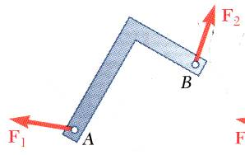
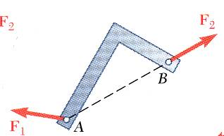
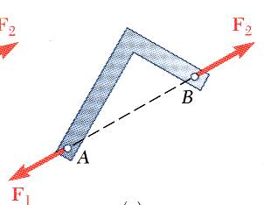
EQUILIBRIUM OF A TWO-FORCE BODY
Consider a plate subjected to two forces F₁ and F₂
For static equilibrium, the sum of moments about A must be zero. The moment of F₂ must be zero. It follows that the line of action of F₂ must pass through A.
Similarly, the line of action of F₁ must pass through B for the sum of moments about B to be zero.
Requiring that the sum of forces in any direction be zero leads to the conclusion that F₁ and F₂ must have equal magnitude but opposite sense.

Slide 21
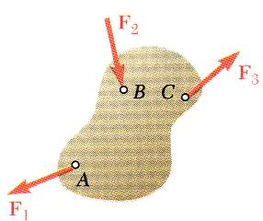
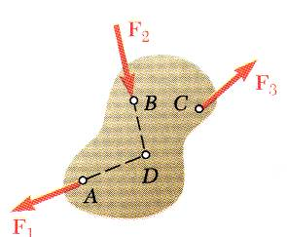
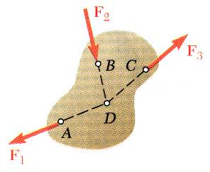
EQUILIBRIUM OF A THREE-FORCE BODY
Consider a rigid body subjected to forces acting at only 3 points.
Assuming that their lines of action intersect, the moment of F₁ and F₂ about the point of intersection represented by D is zero.
Since the rigid body is in equilibrium, the sum of the moments of F₁, F₂, and F₃ about any axis must be zero. It follows that the moment of F₃ about D must be zero as well and that the line of action of F₃ must pass through D.
The lines of action of the three forces must be concurrent or parallel.

Slide 22
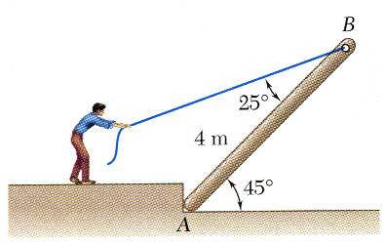
EXAMPLE PROBLEM 4.6
SOLUTION STEPS:
Create a free-body diagram of the joist. Note that the joist is a 3 force body acted upon by the rope, its weight, and the reaction at A.
The three forces must be concurrent for static equilibrium. Therefore, the reaction R must pass through the intersection of the lines of action of the weight and rope forces. Determine the direction of the reaction force R.
A man raises a 10 kg joist, of length 4 m, by pulling on a rope.
Find the tension in the rope and the reaction at A.
Utilize a force triangle to determine the magnitude of the reaction force R.

Slide 23
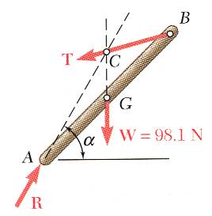
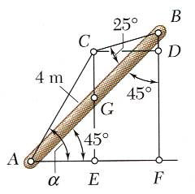
EXAMPLE PROBLEM 4.6 - SOLUTION
Create a free-body diagram of the joist.
Determine the direction of the reaction force R.

Slide 24
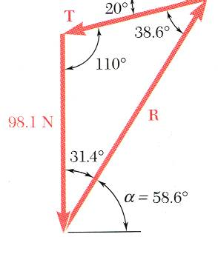
EXAMPLE PROBLEM 4.6 – SOLUTION (continurd)
Determine the magnitude of the reaction force R.

Slide 25
EQUILIBRIUM OF A RIGID BODY IN THREE DIMENSIONS
Six scalar equations are required to express the conditions for the equilibrium of a rigid body in the general three dimensional case.
These equations can be solved for no more than 6 unknowns which generally represent reactions at supports or connections.
The scalar equations are conveniently obtained by applying the vector forms of the conditions for equilibrium,

Slide 26
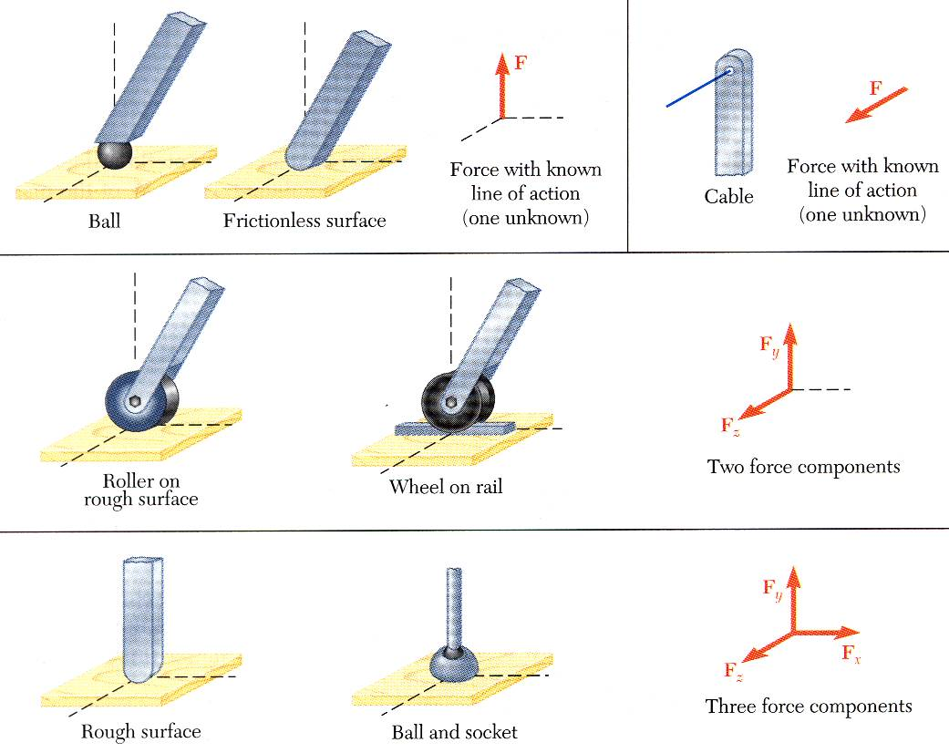
REACTION AT SUPPORTS AND CONNECTIONS FOR A THREE DIMENSIONAL STRUCTURE

Slide 27
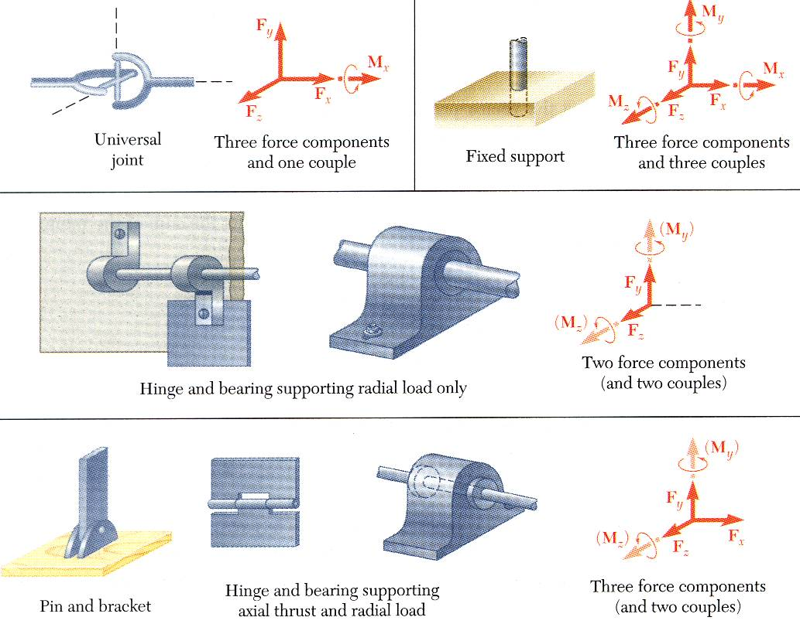
REACTION AT SUPPORTS AND CONNECTIONS FOR A THREE DIMENSIONAL STRUCTURE

Slide 28
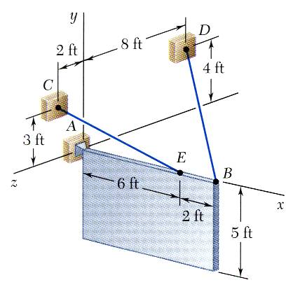
EXAMPLE PROBLEM 4.8
A sign of uniform density weighs 270 lb and is supported by a ball-and-socket joint at A and by two cables.
Determine the tension in each cable and the reaction at A.
STRATEGY:
Create a free-body diagram for the sign.
Express unknown cable tensions in Cartesian vectors.
Solve equilibrium equations to determine cable tensions and the reaction at A

Slide 29
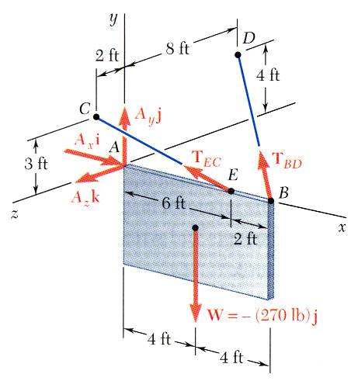
EXAMPLE PROBLEM 4.8 - SOLUTION
Create a free-body diagram for the sign.
Since there are only 5 unknowns, the sign is partially constrained. It is free to rotate about the x axis. It is, however, in equilibrium for the given loading.

Slide 30
EXAMPLE PROBLEM 4.8 - SOLUTION
Solve the 5 equations for the 5 unknowns,
Apply the conditions for static equilibrium to develop equations for the unknown reactions.

Slide 31
EXAMPLE PROBLEM 4.8
REFLECT and THINK: Cables can only act in tension, and the free-body diagram and Cartesian vector expressions for the cables were consistent with this. The solution yielded positive results for the cable forces, which confirms that they are in tension and validates the analysis.
Could this sign be in static equilibrium if cable BD were removed?
The sign could not be in static equilibrium because T_{EC} causes a moment about the y-axis (due to the existence of T_{EC,Z}) which must be countered by an equal and opposite moment. This can only be provided by a cable tension that has a z-component in the negative-z direction, such as what T_{BD} has.
End of Chapter 4

